Slide 1

DATA CENTERS
Designing and implementing on a global scale
2025

Slide 2

A Global Engineering Firm
1.200
11.100
105
38
21
+
+
+
M€
People
Projects
Revenues
Offices
Countries

Slide 3
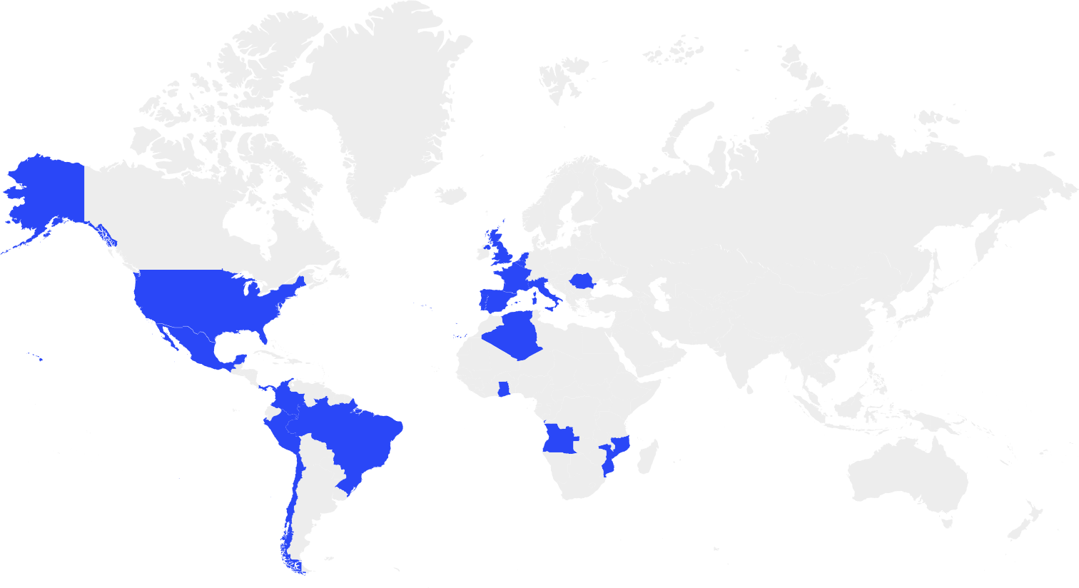
Why Quadrante
With over 25 years of experience, Quadrante is a trusted Global Engineering Consultancy with a proven track record in delivering large-scale, technically complex projects across multiple sectors.
As a multinational company, we have built long-term partnerships with major clients around the world, designing cutting-edge infrastructure that meets the highest technical standards.
Our highly qualified and multidisciplinary teams work in seamless coordination, providing real-time, tailored solutions that reflect our deep understanding of client needs.
Every proposal we deliver is carefully adapted to environmental and societal constraints, ensuring both technical excellence and financial viability — always with a firm commitment to long-term sustainability and client satisfaction.
Offices
Algeria
Angola
Brazil
Belgium
Chile
Colombia
Costa Rica
France
Ghana
Guatemala
Italy
Mexico
Mozambique
Netherlands
Panama
Peru
Portugal
Romania
Spain
United Kingdom
USA

Slide 4


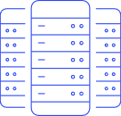

Our Vision
Next-Generation Data Centers – Powering Innovation with Reliability
Industry
Bringing cutting-edge factories to life with state of the art Engineering
Airports
Creating critical infrastructure for Mobility
Data Centers
Leading the design of the Digital Transformation
Transmission Lines and Substations
Designing the Energy backbone and supporting the Energy Transition
Hospitals
Providing modern, resilient Healthcare infrastructure
From Industry to Energy, from Hospitals to Airports, we have always engineered infrastructures that cannot fail.
Data centers are the next step.

Slide 5





Our Expertise
Core Foundations of Our Data Centre Expertise
Engineering
Excellence & Sustainability
Local Regulations
and Permissions
Total Design Approach
Connected to the Industry
Precision-engineered systems tailored for uptime and performance powering AI-ready, sustainable infrastructure, with the highest PUE and WUE standards
Full compliance with planning, zoning, and environmental permits, and extensive knowledge of local power grid
With experts in Engineering, Architecture, Energy, Environment and Sustainability, we provide integrated solutions and drive projects forward
QUADRANTE is a member of Data Center Associations in Portugal, Spain and Brazil, with a strong connection to the local industry

Slide 6
Total Design Approach for Data Centers
A one-stop shop for all Data Center-related services
Environment & Sustainability
Architecture
& Licensing
Transmission Lines
Cooling
Power
Concept, Test Fit and Masterplan
Substation Design
BMS
Civil Engineering & Fire Safety
Renewables
Telecom
BIM & Digital Twins

Slide 7
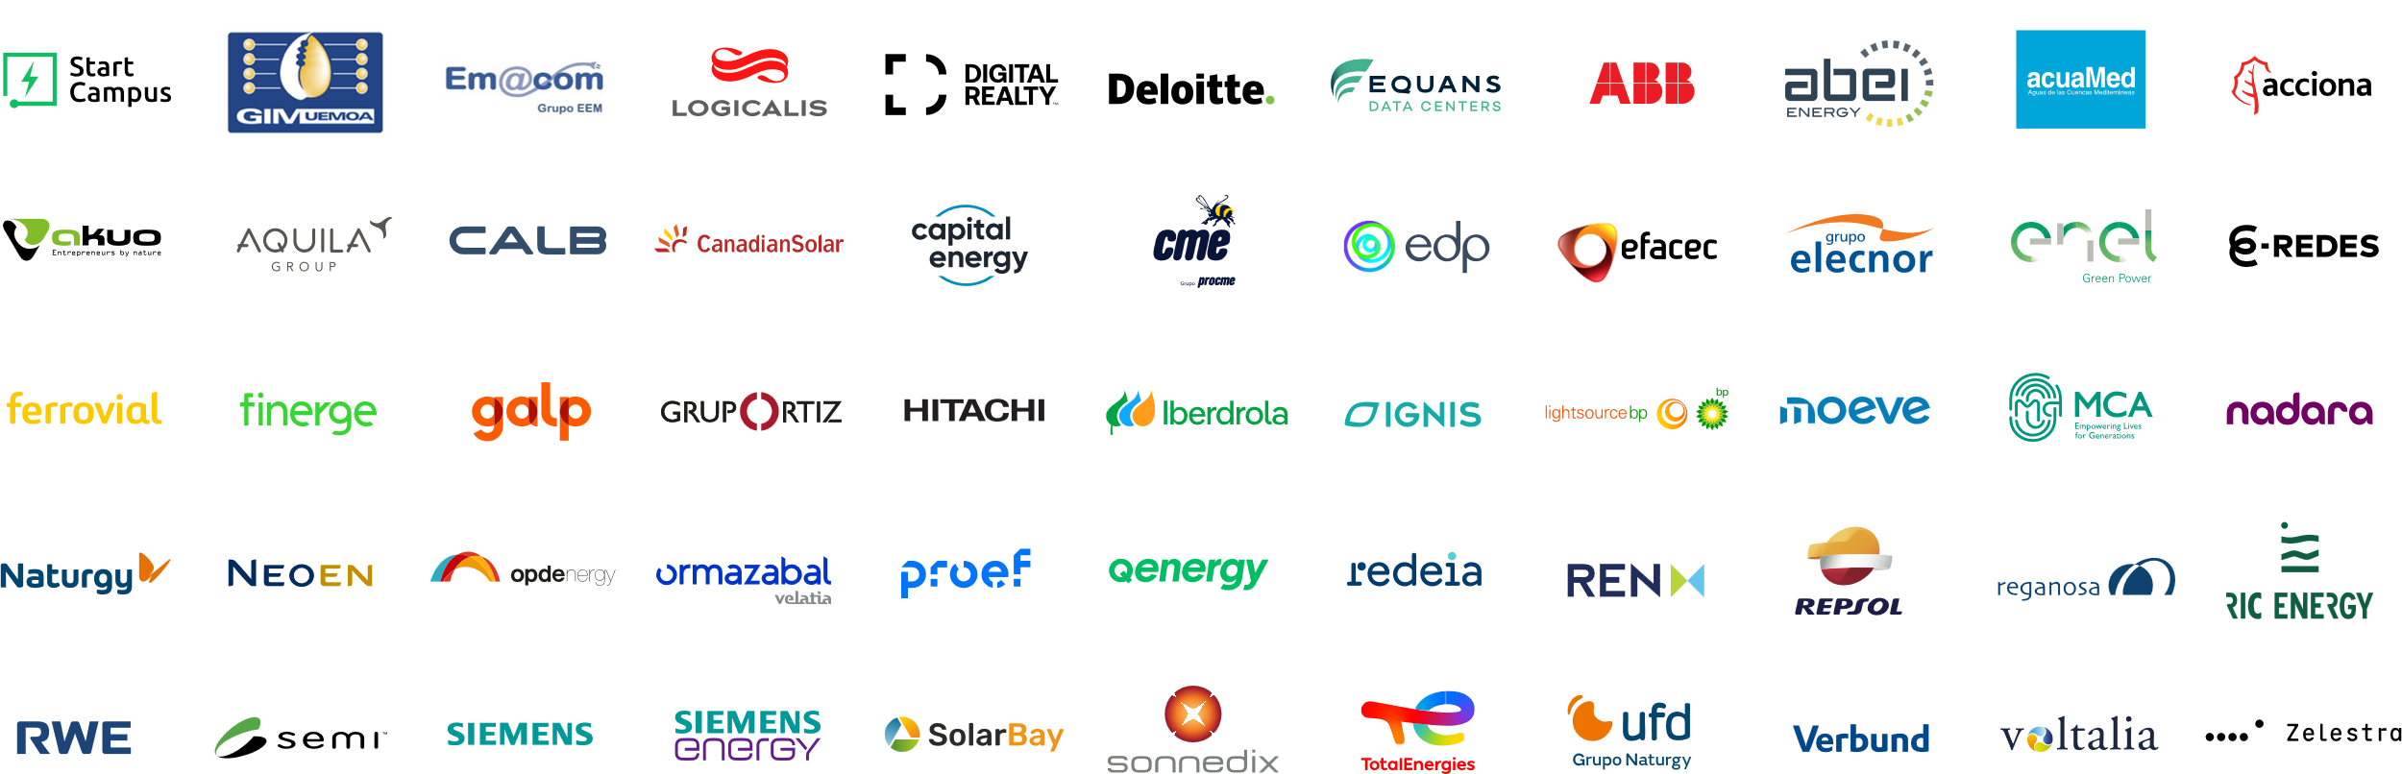
Main Clients
We establish a deep commitment with our clients, and therefore we intent to exceed their expectations in every project.

Slide 8
From Vision to Execution
Lifecycle Engineering Services - RIBA Stages
0 - 2
3 - 4
5 - 6
Feasibility &
Site Selection​
Design
Construction & Comissioning
Preliminary & Detail Design
Detailed Design
Location risk analysis and site selection services
Technical Due Diligence
Masterplan and Concept Design
Assessment of Environmental Constraints
Energy Connection feasibility
Design of Power, cooling, communications, physical security, fire safety, SCADA and other automation solutions, BMS/DCIM monitoring and control solutions.
Uptime Institute Tier level assessment and design (I, II, III or IV)
Permitting
Computer load inventory and rack allocation studies for energy and cooling efficiency
CFD Studies
Energy sustainability and GHG emissions studies and strategy for data centers
PUE/WUE Reports
CAPEX and OPEX budgeting advice
Overall technical coordination and supervision
Procurement and Tender services
Special Technical Assistance services
Commissioning support
Cost Control ● Project Management ● Renewable power projects ● Substation and Transmission Lines design ● Environmental Impact studies ● Digital Twins

Slide 9
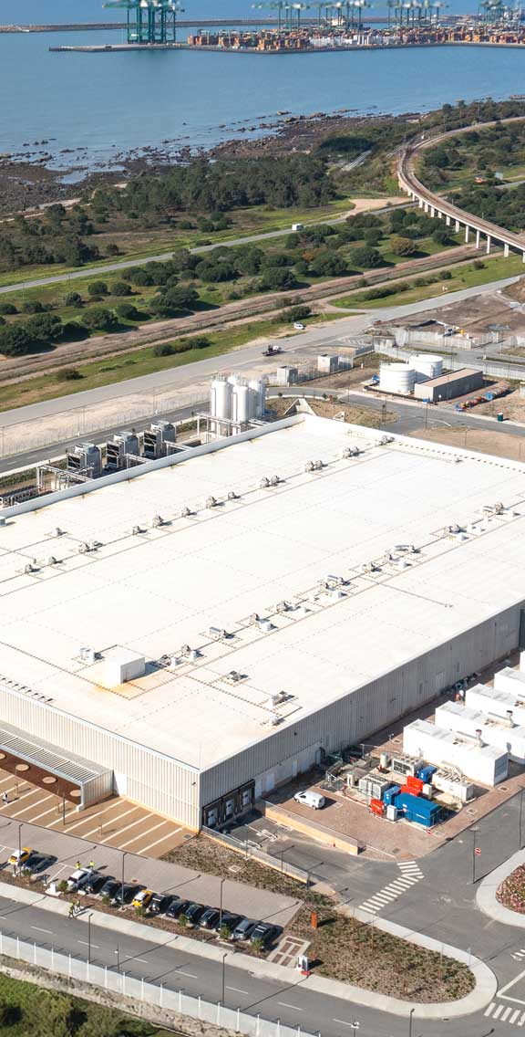

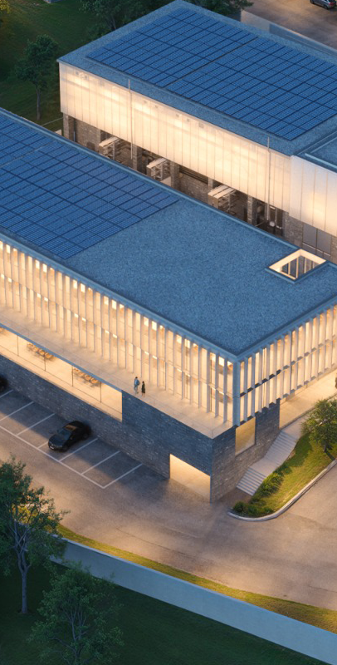

Our Projects
Engineering the expansion of Portugal’s largest Data Center
Delivering cutting-edge enterprise solutions with resilient certified design
Tier III certified design to support Madeira’s digital future
Building the future of AI infrastructure in North Africa
Option Study for AI-ready Data Center in Tunisia
START CAMPUS SIN01 Expansion
TIER III Data Center in Sumbe
Virtudes & Machico Data Centers
Date 2025
Client Start Campus
Country Portugal
IT Power Confidential
Date 2024-2025
Client Logicalis
Country Angola
IT Power 1 MW
Date 2025
Client EMACOM
Country Portugal
IT Power 600 kW
Date 2025
Client Deloitte
Country Tunisia
RIBA Stages 3-4 | Design​
RIBA Stages 3-4 | Design​
RIBA Stages 5-6 | Construction Supervision & Cost Control​
RIBA Stages 3-4 | Design​
RIBA Stages 5-6 | Construction Supervision​
RIBA Stages 0-2 | Feasibility & Site Selection​

Slide 10
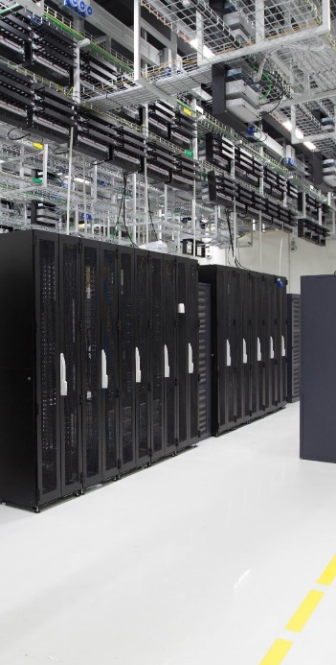

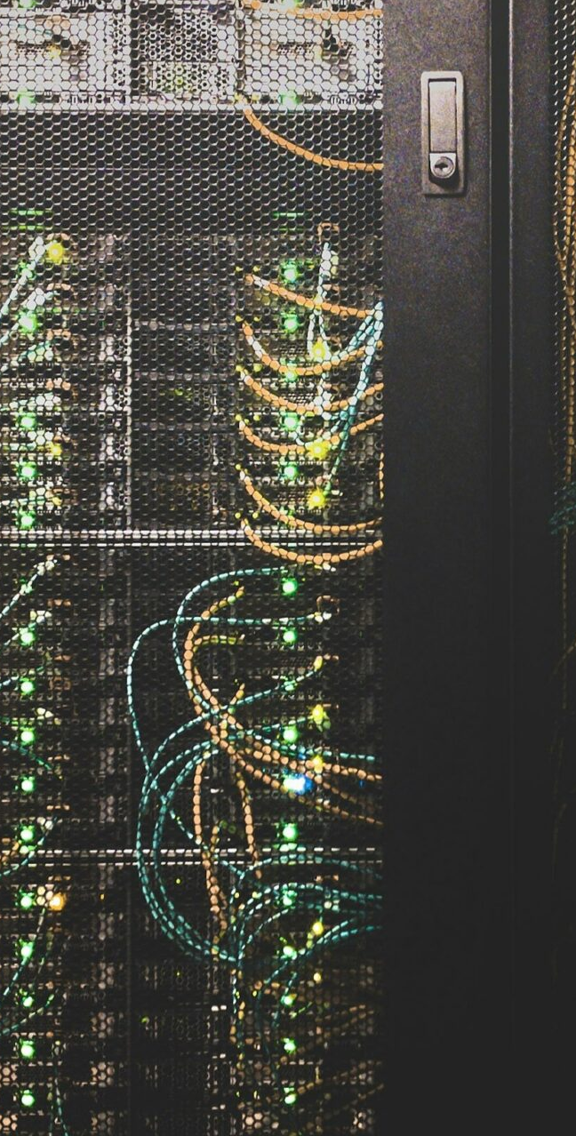
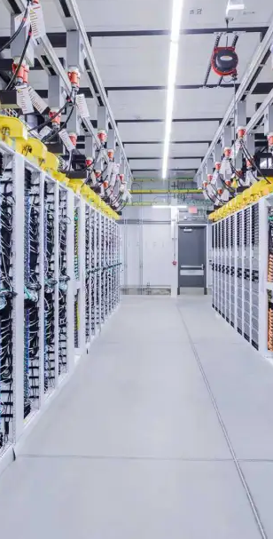
Our Projects
Strengthening West Africa’s digital backbone with resilient infrastructure
Envisioning a new hub of digital capacity on Portugal’s Atlantic coast
Supporting strategic investment through technical expertise
Bringing world-class resilience to the financial heart of Cape Verde
Refurbishment and Tier III certification of Bank of Cape Verde Data Center
Feasibility Studies for Data Centers in Setúbal and Palmela
Feasibility and Technical Due Diligence for Data Center in Oeiras
3 Data Centers in Dakar and Abidjan
Date 2024
Client GIM UEMOA
Country Senegal
IT Power 1 MW (each)
Date 2024-2025
Client Confidential
Country Portugal
IT Power 100 MW
Date 2025
Client Digital Realty
Country Portugal
Date 2025
Client Banco de Cabo Verde
Country Cape Verde
RIBA Stages 0-2 | Feasibility & Site Selection​
RIBA Stages 0-2 | Feasibility & Site Selection​
RIBA Stages 0-2 | Feasibility & Site Selection​
RIBA Stages 3 & 4 | Design

Slide 11
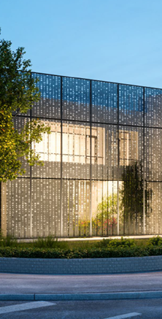
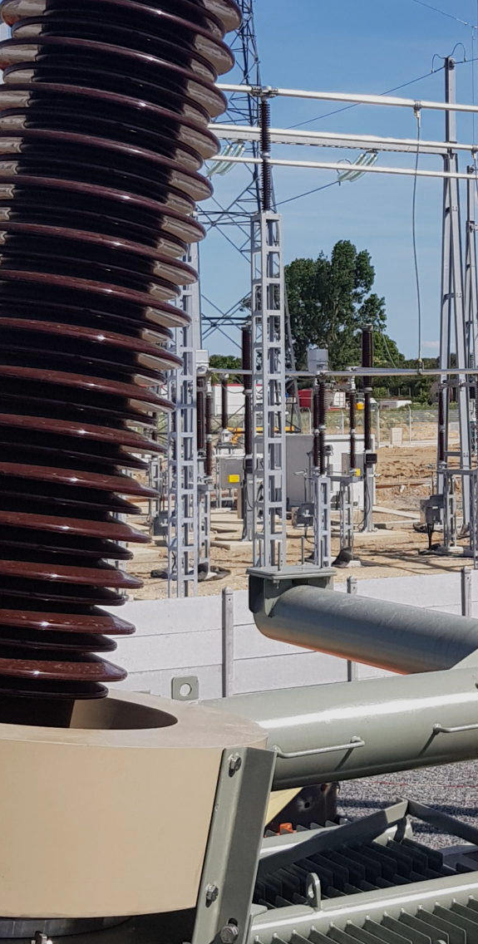
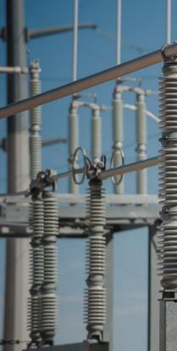
Our Projects
Delivering sustainable design for state-of-the-art enterprise infrastructure
Delivering the power backbone for one of Europe’s largest data campuses
Designing the power infrastructure of Chile’s technological hub
Powering a national data hub with a state-of-the-art substation
New AR Telecom Headquarters and Data Center
START CAMPUS - Electrical Substation
Google Data Center - Electrical Substation
Altice Covilhã – Electrical Substation
Date 2023
Client AR TELECOM
Country Portugal
Date 2023
Client Siemens Energy
Country Portugal
Date 2017-2018
Client ABB Chile
Country Chile
Date 2023
Client EFACEC
Country Portugal
RIBA Stages 3-4 | Design​
RIBA Stages 3 & 4 | Design
RIBA Stages 3 & 4 | Design
RIBA Stages 5-6 | Construction Supervision​
RIBA Stages 3 & 4 | Design

Slide 12
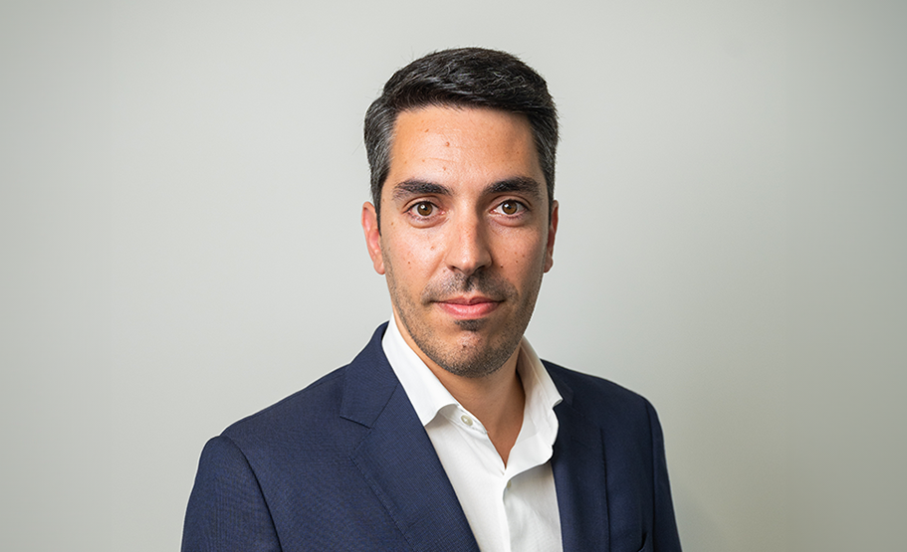
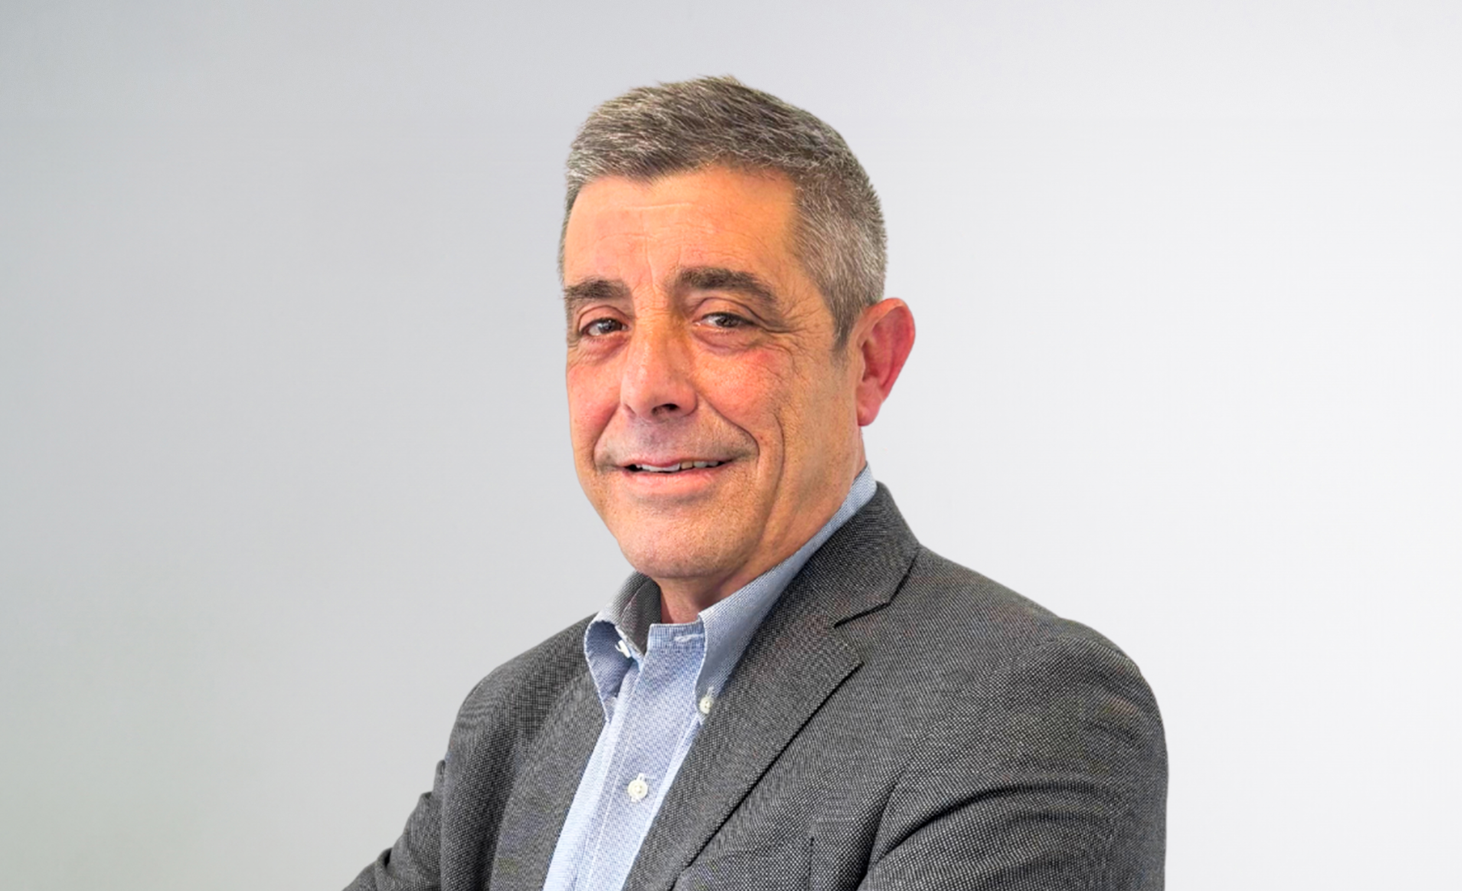
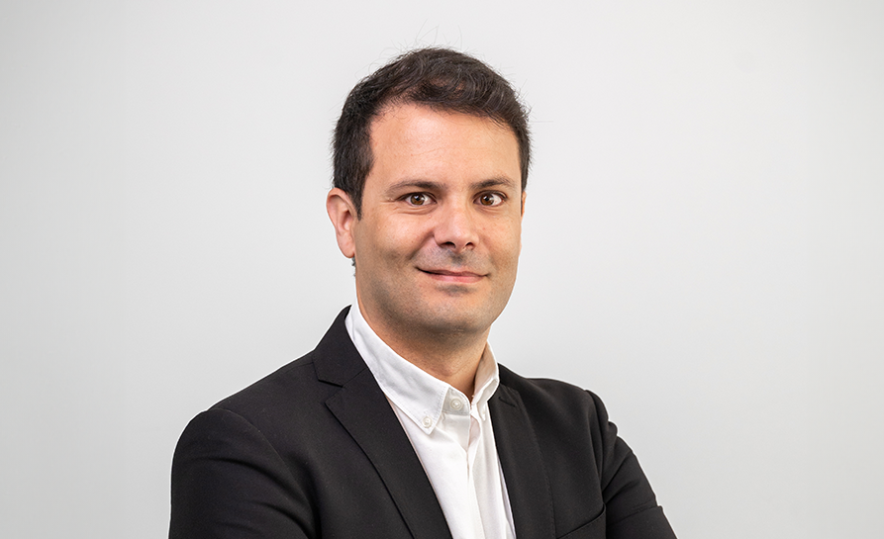
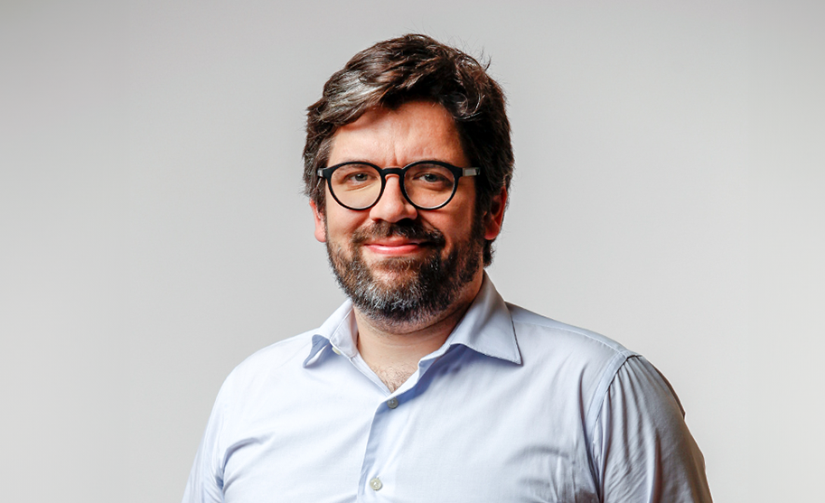
Main Team
João Rocha
Matías Ramón Arteu
Armando Santos
António Lorena
Client Manager - Global Projects - Data Centers
Portugal + Middle East and Africa Market
Head of Data Centers Business Unit
Spain + LATAM
Head of Energy Business Unit
Portugal + Middle East and Africa Market
Head of Sustainability
Global
Holder of a Master's Degree in Civil Engineering from FEUP, with specialization in Structures, João Rocha boasts 12 years of professional experience in Engineering and Consulting.
Throughout his professional career, he has developed Building Structure projects of various types, including museums, offices, residential buildings, hotels and industrial buildings, in various markets, including Portugal, Brazil, Angola and Switzerland. He joined the Quadrante Group in 2019 and currently serves as Head of Buildings and Urban Development for the Portuguese, Middle Eastern and African markets.
Matías Ramón Arteu is a highly experienced professional with over two decades of expertise in managing complex projects within demanding and mission-critical environments. Since 2005, Matías has played a pivotal role in the development of data center projects at Schneider Electric, establishing a robust foundation in critical power infrastructure across key sectors including nuclear energy, aviation, and petrochemicals.
Matías complements his technical background in Industrial Engineering with advanced executive education such as a PDG from IESE Business School, a certified Professional Manager by INSEAD and possesses a Diploma in Marketing Management from EADA Business School.
Currently serving in dual executive capacities as Director of Data Centers at Meta Engineering and Director of Energy at Izharia (both integral companies within the Compass Group), Matías lead the development and implementation of cutting-edge solutions across the energy and data center sectors.
Master's in Electrical Engineering, with a specialization in Electrical Energy Systems from ISEP, has more than 15 years of national and international experience in energy production, transportation, and distribution projects, such as photovoltaic solar plants, energy storage systems, wind farms, mini-hydro plants, substations, and transmission lines up to 500 kV, especially in Portugal, Angola, Mozambique, Algeria, Chile, among others.
Armando Santos has been linked to them since their conception phase (studies and projects), through procurement, construction, assembly, and commissioning.
At Quadrante Group since 2017 he is currently Global Partner, Head of the Energy Business Unit and Global Account Lead of the Energy Business Sector, for the Portuguese, Middle Eastern and African markets.
António Lorena holds a master’s degree in environmental engineering from IST and has 16 years of experience in the fields of waste management, circular economy, and public policies.
Currently he is the Head of the Sustainability Business Unit of the Quadrante Group and has been Managing Partner of 3drivers since 2016. At 3drivers he has also coordinated several strategic projects, having worked with the corporate and public sectors.
His work includes projects such as the definition of the Agenda for Carbon Neutrality and the Circular Economy in the AEC Sector, as well as the drafting of the National Strategy for the Efficient Use of Resources. He has collaborated to promote the circular economy in Portugal, in particular co-authoring the 2030 National Research and Innovation Agenda for the Circular Economy. He is also the author of several scientific papers on the evaluation of waste management policies.

Slide 13
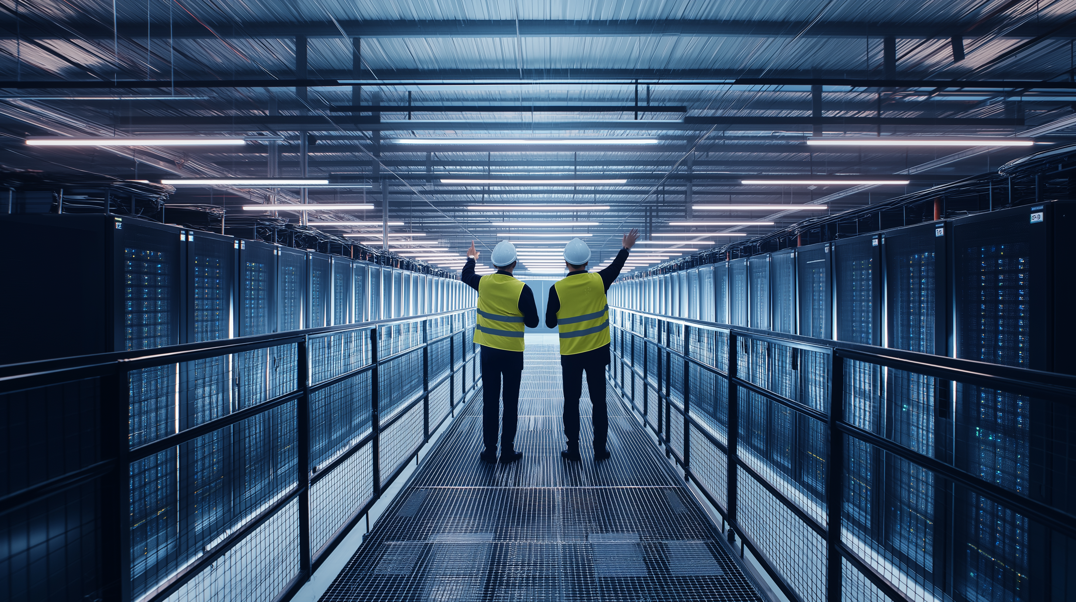
Critical Infrastructures for a resilient future

Slide 14

PORTUGAL
Alfrapark - Estrada do Seminário 4 Edifício C - Piso 1
Alfragide 2614-523 Amadora
quadrante@quadranteglobal.com
+351 21 843 7930
quadranteglobal.com
SPAIN
Bac de Roda 64, Edifício D, Planta 2ª
08019 Barcelona
info@metaengineering.com
+34 93 970 1990
metaengineering.com
SPAIN
Parque Empresarial Alvia – Edificio 1.
José Echegaray 8- PTA 1º Oficina 2- 4
28232 Las Rozas de Madrid, Madrid (Spain)
info@izharia.com
+34 91 603 0217
izharia.com

